Slide 1
Thurston County community planning
Planning commission – December 7th, 2022
Grand Mound Work Session & Planning Commission Recommendation

Slide 2
Process
Process to Date (2022)
4 Planning Commission Work Sessions
Community Open House
Public Hearing – 14 oral comments
~30 Written Public Comments
Requesting Two Recommendations
1. Subarea Plan, Thurston County Code Changes, and Land Use & Rezone Requests
2. Expansion of Grand Mound UGA – yes or no
Notes:
One recommendation will address the Subarea Plan, Thurston County Code, and which site-specific proposals to recommend rezoning. A second recommendation is needed that addresses whether Planning Commission recommends an expansion to the UGA or not.

Slide 3
Planning Commission Recommendation
Components of Recommendation
Grand Mound Subarea Plan
Thurston County Code (Title 20, Chapters 20.15, 20.21A, 20.25, 20.27, 20.28, 20.40, 20.44, 20.45, and 20.35)
Land Use & Zoning Amendment Requests
Steelhammer Family Trust
Fire District #14
Morgan
Tribal Trust Lands
Jackson & Singh
UGA Expansion – If Yes, then recommend on land use & zoning for 3 below
Wilmovsky
Deskin
Black Lake Quarry
Notes:
PC were provided a staff report that includes a summary of changes, staff recommendations, reasoning, and options to consider. It included several attachments, including additional background information, a new land use analysis memo from TRPC on the amendment requests, the draft subarea plan, the draft code, a map of the proposed land use and zoning amendments, and the written comment provided during the open comment period.

Slide 4
Thurston County community planning
Planning commission – December 7th , 2022
Grand Mound Subarea Plan
Notes:
Introduce yourself

Slide 5
Subarea Plan
Guides growth in UGA Main changes:
Land use data
Population forecasts
Housing supply and demand
Revised goals and policies
Transportation study
Changes to Draft
Additional Language:
Background info (1996)
Agriculture
Aquifer
Employment
Sewer & water systems

Slide 6
Subarea Plan
Options for Consideration Option A: Recommend approval of the draft.
Brings plan up to date with other county documents.
Takes into consideration public comment and community recommendations.
Option B: No Change.
Does not bring plan up to date with other county documents and policies
Does not update to include new public comment and community recommendations.

Slide 7
Thurston County community planning
Planning commission – December 7, 2022
Thurston County Code Amendments

Slide 8
Thurston County Code
Draft Code
Convert Grand Mound Design Guidelines from 1996 Subarea Plan
Reduce Minimum lot widths in R 3-6/1 and R 4-16/1 zones
Removes references to 1996 Development Guidelines in other zones
Changes to Draft
Clarify consistency with Road Standards and other requirements

Slide 9
Thurston County Code Amendments
Options for Consideration Option A: Recommend approval of the draft.
Brings standards into development code.
Update language based on comments from other county departments.
Option B: No Change.
Maintains outdated standards.
Does not take department comments into considerations.

Slide 10
Thurston County community planning
Planning commission – December 7, 2022
Land Use & Zoning Amendment Requests

Slide 11
Land Use & Zoning Amendment Requests
Included in the Recommendation
Land Use & Zoning Amendment Requests
Steelhammer Family Trust
Fire District #14
Morgan
Tribal Trust Lands
Jackson & Singh
Notes:
Since the Jackson & Singh proposal is located outside of the UGA, it has additional rural policies that must be met from the Comprehensive Plan, which we’ll talk about more.

Slide 12
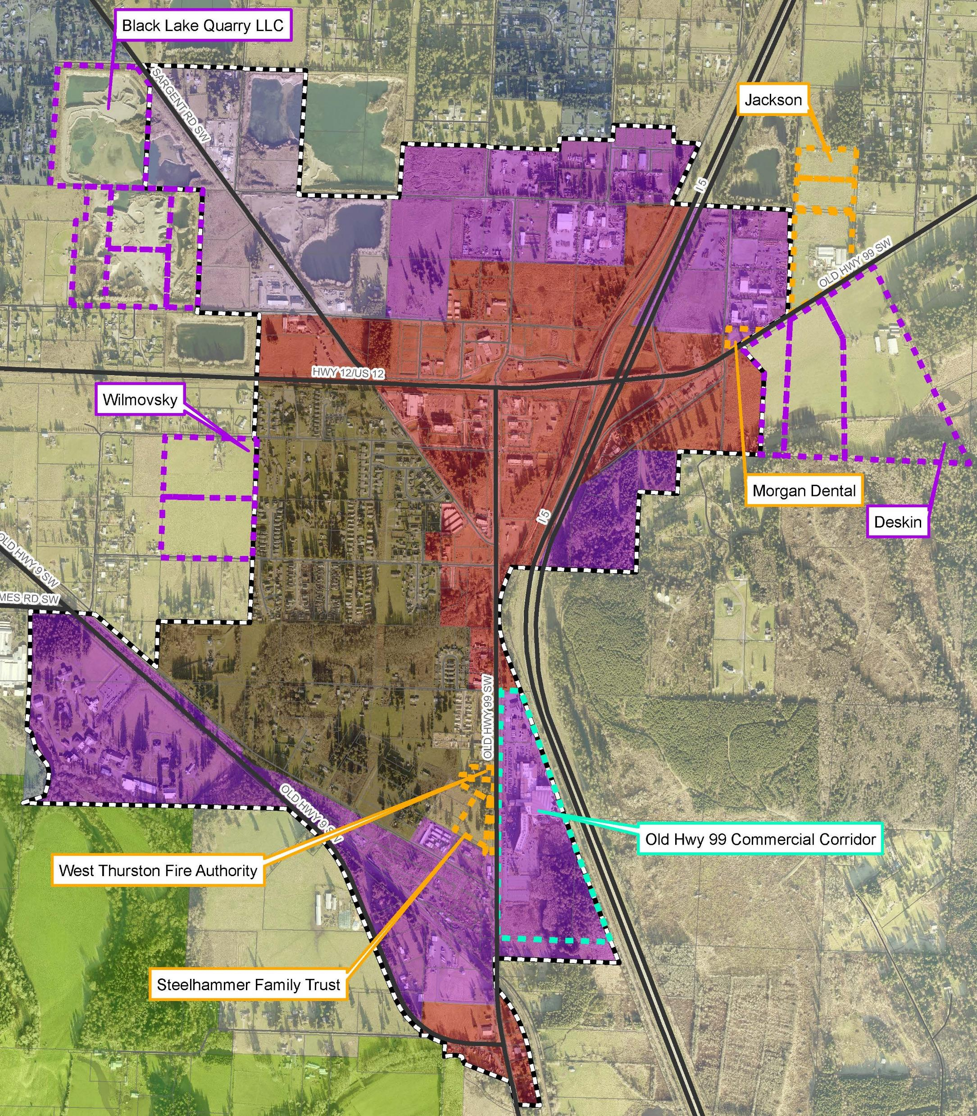
Rezones
Rezones should consider:
Subarea Plan
Comprehensive Plan policies
County-wide Planning policies
Public comment

Slide 13
Rural Rezone policies
Rezoning a rural property requires consistency with the Comprehensive Plan’s Land Use Chapter Objective B, Policy 10:
Rezoning of any parcel with a rural designation to a different designation should only occur when:
Circumstances have substantially changed since the current land use designation/zoning was adopted and the definition, characteristics or locational guidelines for the current district no longer apply;
The rezone would promote the general welfare of the affected community; or
The rezone would maintain or enhance environmental quality

Slide 14
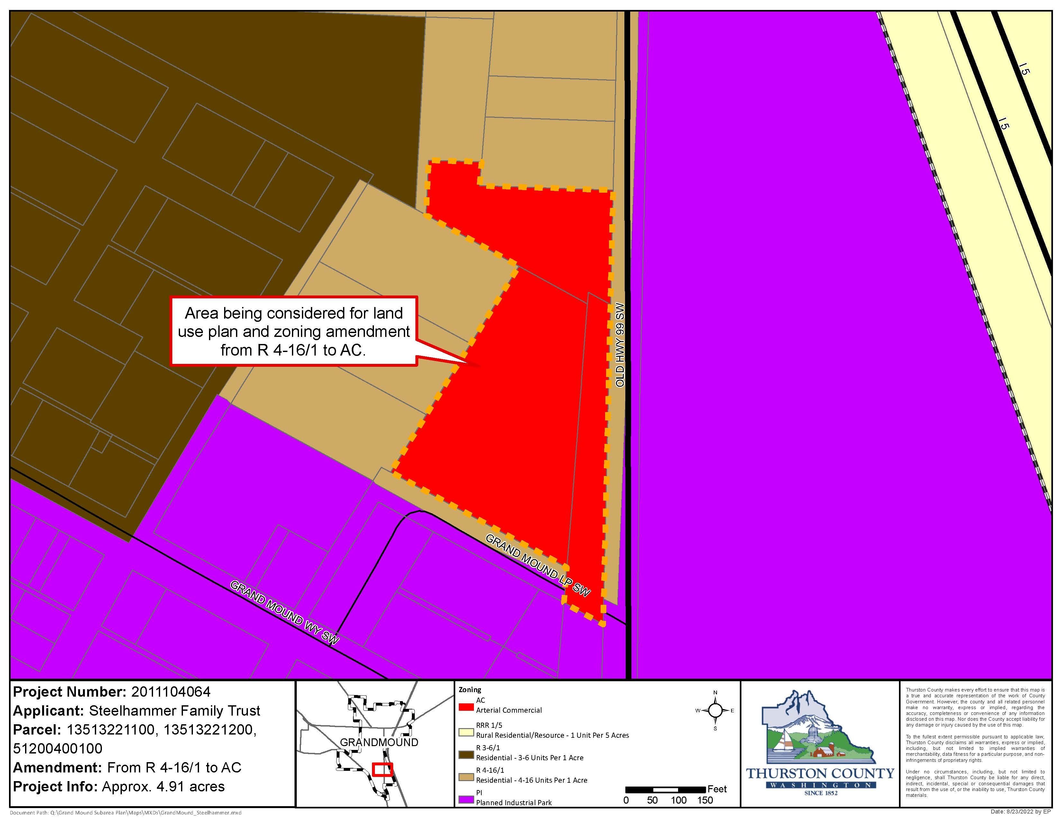
Steelhammer Family trust
4.91 total acres
Current: R4-16/1
Proposed: Arterial Commercial (AC)
Proposal removes 19-78 (potential) residential units
Undeveloped
Property shown as proposed zone: (AC)
Notes:
In case further discussion is needed

Slide 15
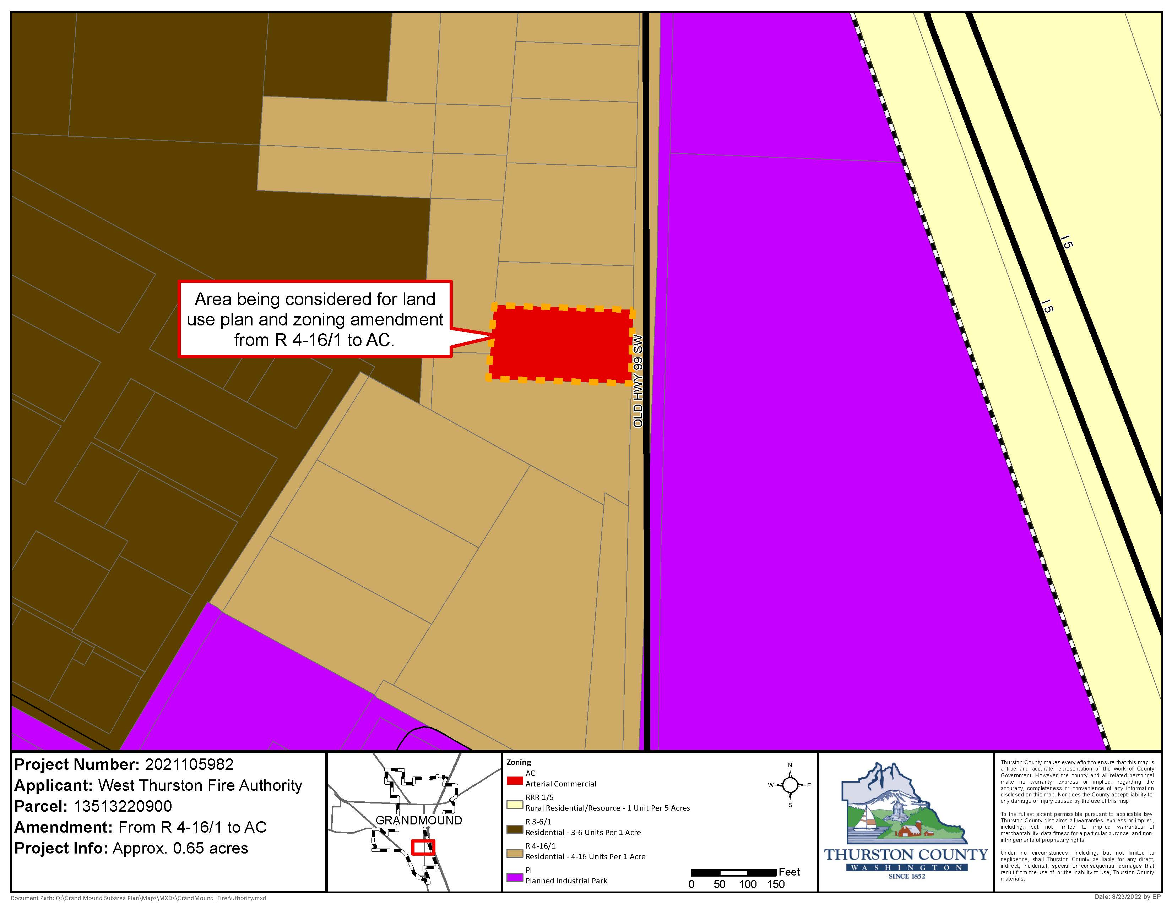
Fire District #14
0.65 acres
Current: R4-16/1
Proposed: Arterial Commercial (AC)
Proposal removes 2-8 (potential) residential units
Developed, Old Fire Station
Property shown as proposed zone: (AC)
Notes:
In case further discussion is needed

Slide 16
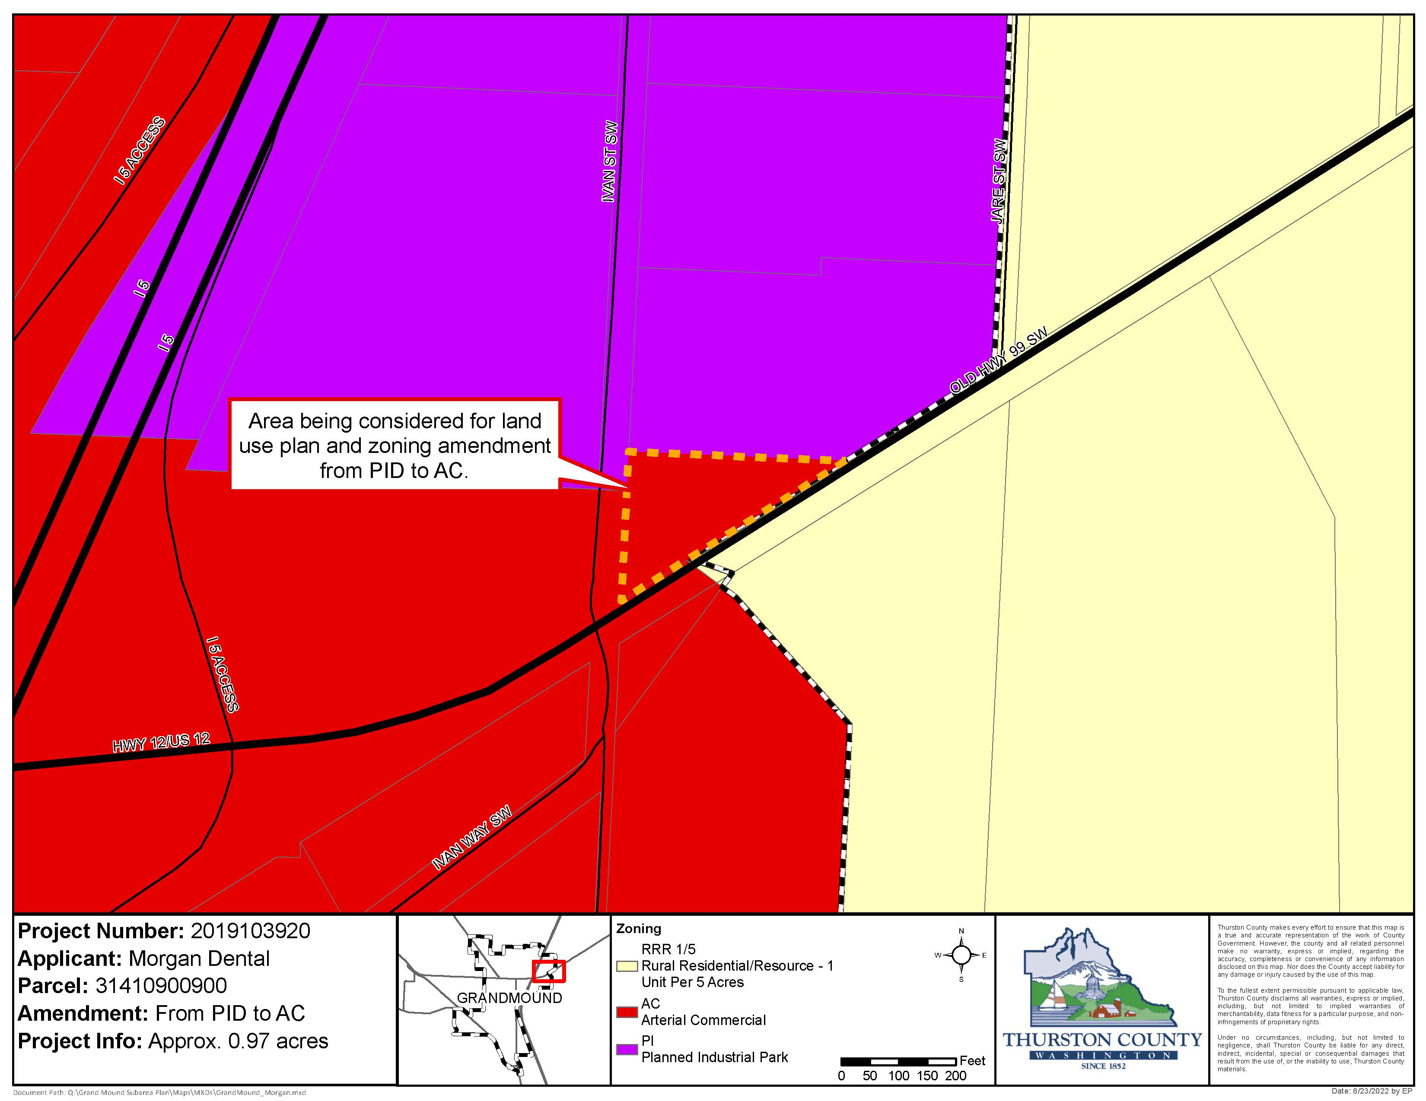
Morgan
0.97 acres
Current: Planned Industrial Park District (PI)
Proposed: Arterial Commercial (AC)
Property shown as proposed zone: (AC)
Notes:
In case further discussion is needed

Slide 17
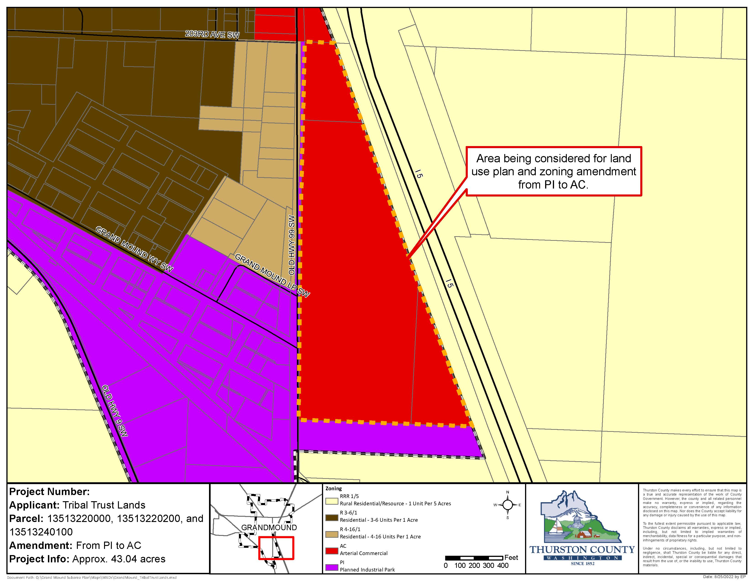
Tribal Trust Lands
43. 04 acres
Current: Planned Industrial Development (PI)
Proposed: Arterial Commercial (AC)
Developed, Great Wolf Lodge
Existing commercial use
Property shown as proposed zone: (AC)
Notes:
In case further discussion is needed

Slide 18
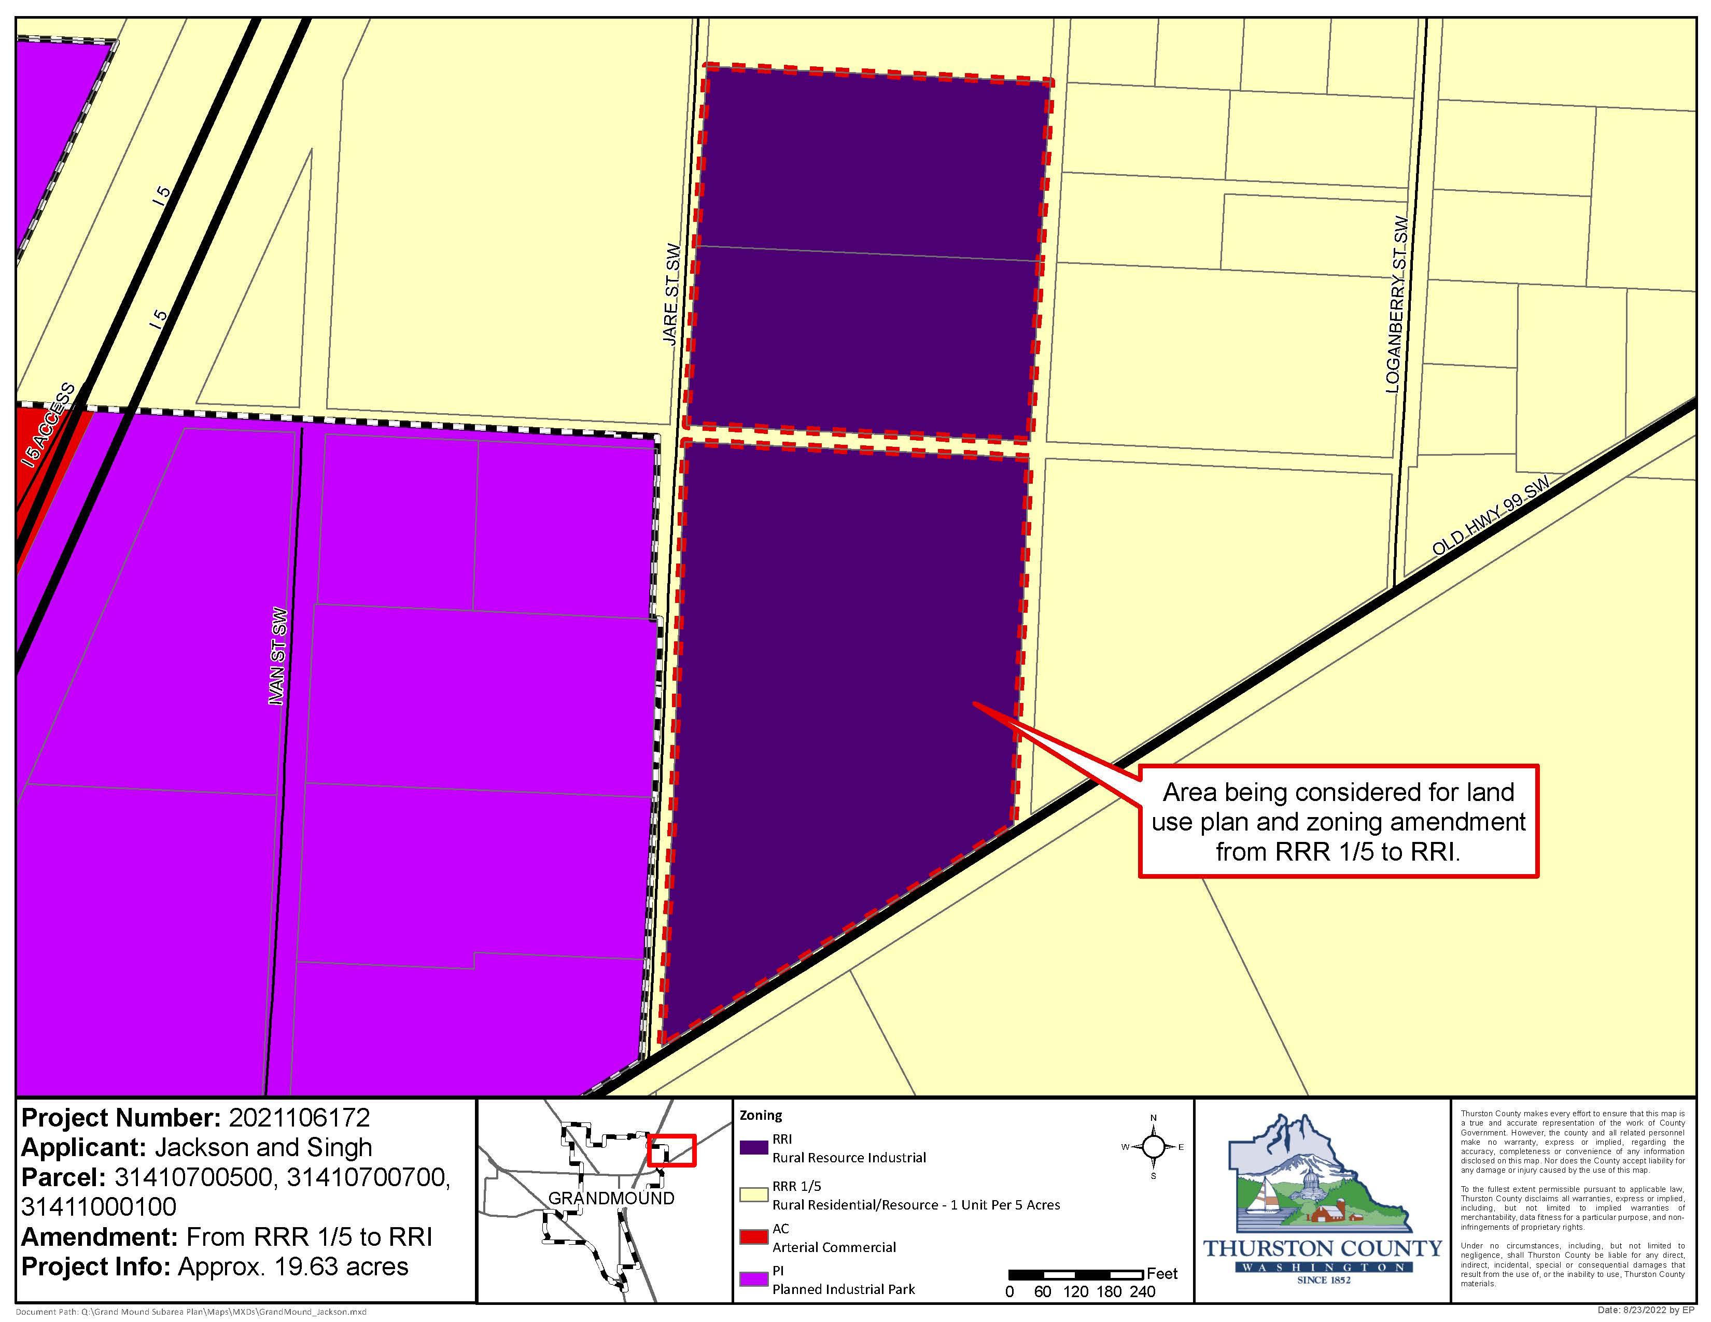
Jackson & Singh
19.63 acres
Current: RRR 1/5
Requested: Rural Resource Industrial (RRI)
Outside of UGA, but not requesting expansion of UGA
Inconsistency with additional Comprehensive Plan policy requirements
Property shown as proposed zone: (RRI)
Notes:
This property is the only proposal of the 5 Land Use and Zoning Amendment Requests to have a clear inconsistency with Comprehensive Plan policies.

Slide 20
Land Use & Zoning Amendment Requests
Options for Consideration Option A: Recommend approval of land use and zoning amendment changes to specific proposals.
Steelhammer Family Trust (a), Fire District #14 (b), Morgan (c), Tribal Trust Lands (d), and/or Jackson & Singh (e)
Rezone of properties is consistent with Comprehensive Plan policies and CWPPs.
Impact to surrounding community.
Option B: No change.
Does not meet the applicant’s requests.
No change to surrounding community from current land use.

Slide 21
Thurston County community planning
Planning commission – December 7, 2022
Expansion to Grand Mound UGA

Slide 22
UGA Expansion Requests
Included in the Recommendation
UGA Expansion
Wilmovsky
Deskin
Black Lake Quarry
Staff Summary: There is not enough evidence to support an expansion of the Grand Mound Urban Growth Area.

Slide 23
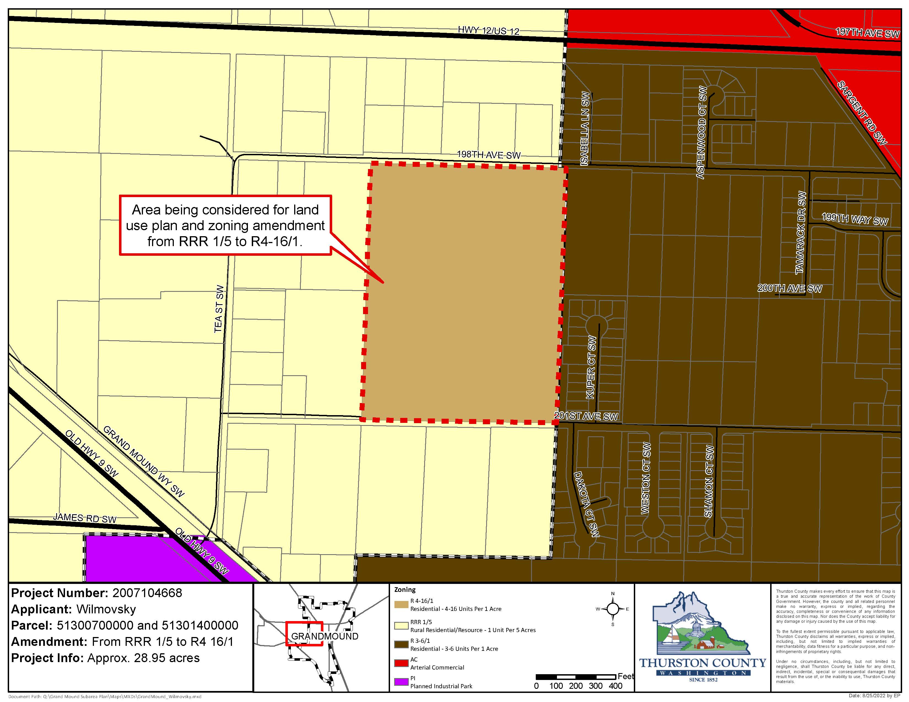
Wilmovsky
UGA Expansion
28.95 acres
Current: RRR 1/5
Proposed: R4-16/1
Proposal adds 116-464 (potential) residential units
Property shown as proposed zone: (R4-16/1)
Notes:
In case further discussion is needed

Slide 24
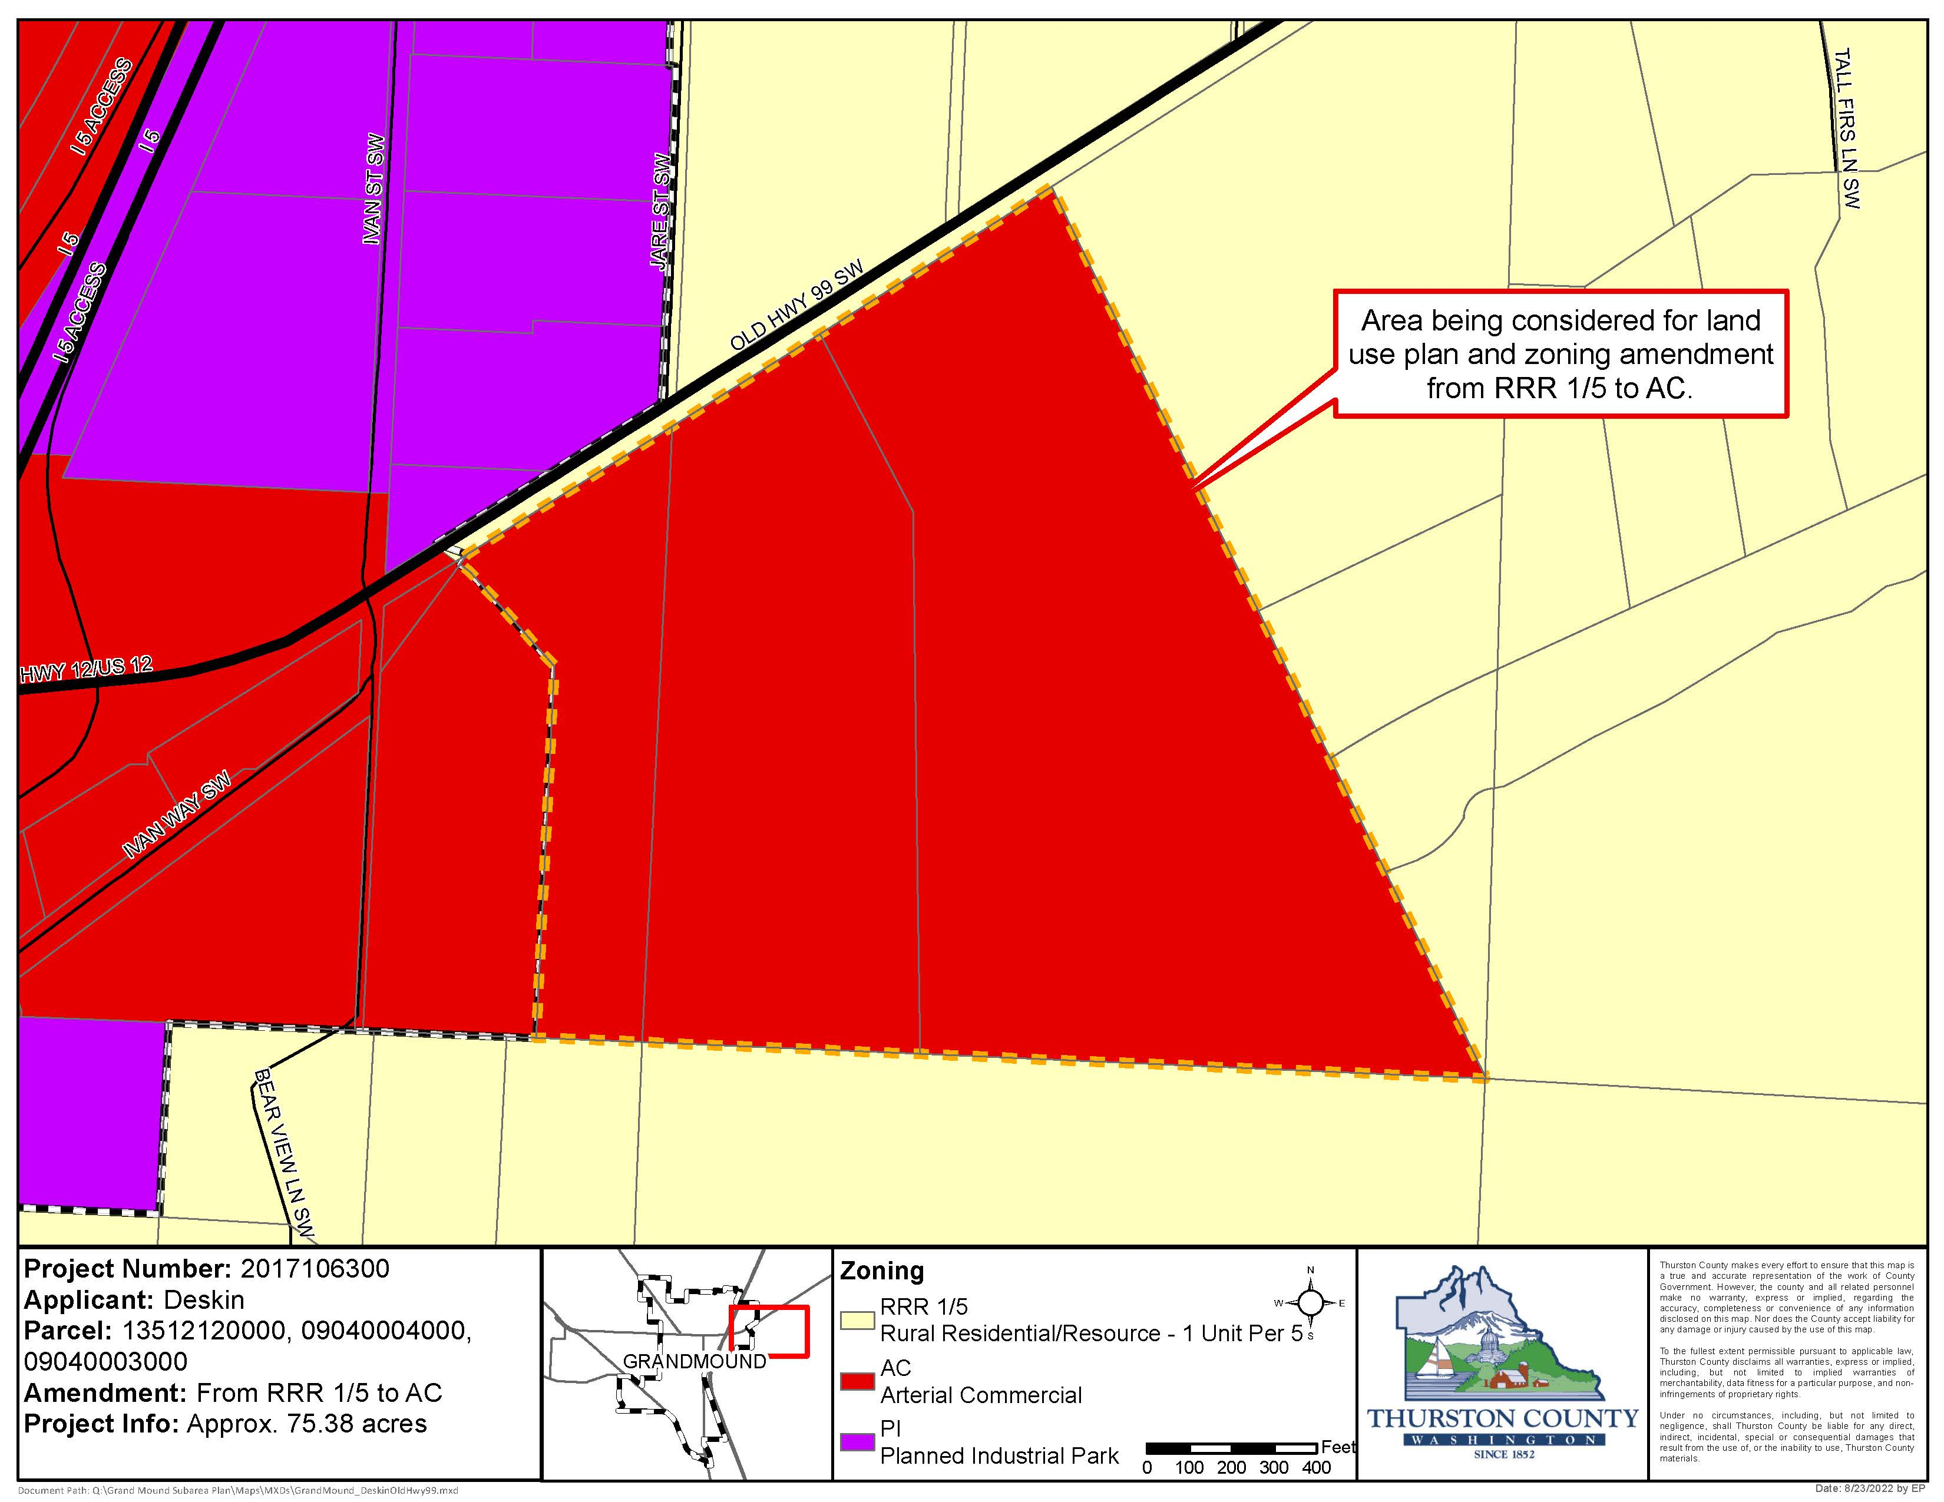
Deskin
UGA Expansion
75.38 acres
Current: RRR 1/5
Proposed: Arterial Commercial (AC)
Property shown as proposed zone: (AC)
Notes:
In case further discussion is needed

Slide 25
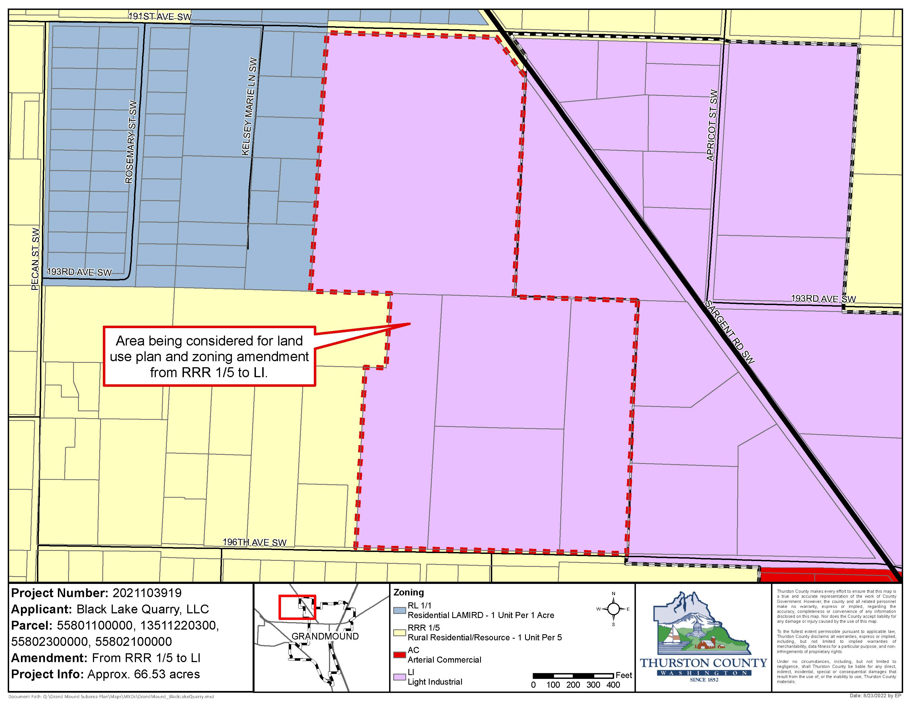
Black Lake Quarry
UGA Expansion
66.53 acres
Current: RRR 1/5
Proposed: Light Industrial (LI)
Property shown as proposed zone: (LI)
Notes:
In case further discussion is needed

Slide 27
Expansion to UGA
Options for Consideration Option A: No change.
Maintains consistency with GMA and CWPP
Does not meet the applicant’s requests
Will be reviewed by UGM Committee
Option B: Recommend amending the UGA
Wilmovsky (a), Deskin (b), and/or Black Lake Quarry (c)
The SEPA process would require the applicants to consider environmental and traffic impacts.
No evidence to support consistency with GMA and CWPP
Will be reviewed by UGM Committee

Slide 28
DRAFT Planning Commission Recommendation
Move to recommend [approval of/no change to] of the Grand Mound Subarea Plan; [an amendment to/no change to] 5 associated land use and rezoning amendments including Steelhammer, Fire District 14, Morgan, Tribal Trust Lands, and Jackson & Singh properties; and [an amendment to/no change to] the Thurston County Code Chapters 20.15, 20.21A, 20.25, 20.27, 20.28, 20.40, 20.44, 20.45, and 20.36 to incorporate Grand Mound Design Guidelines and lot width standards.
Move to recommend [an amendment/no change] to the Grand Mound Urban Growth Area, and [to amend/make no change to] the land use and associated zoning of the Wilmovsky, Deskin, and Black Lake Quarry properties.
Each land use and rezone request can have a different outcome.

Slide 29
Questions?
Amelia Schwartz, Associate Planner
Amelia.Schwartz@co.thurston.wa.us
(360) 786-5474
Project Contacts:
Kaitlynn Nelson, Associate Planner
Kaitlynn.Nelson@co.thurston.wa.us
(360) 522-0508

